Slide 1
🏥 Hospital Data Analysis using Sql
By Deepak

Slide 2

Creating Data base
CREATING DATABASE (NAME = Hospital)
USE DATABASE

Slide 3
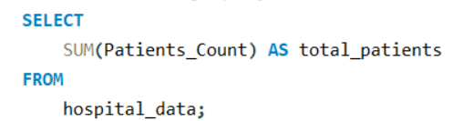

Write an SQL query to find the total number of patients across all hospitals.

Slide 4
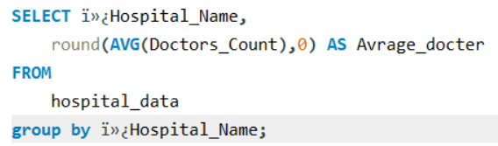
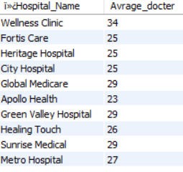
Retrieve the average count of doctors available in each hospital.

Slide 5
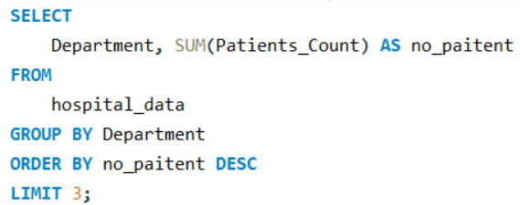

Find the top 3 hospital departments that have the highest number of patients.

Slide 6
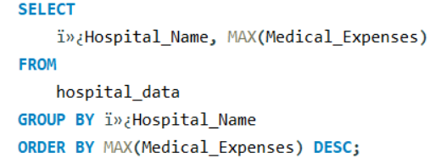
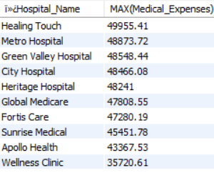
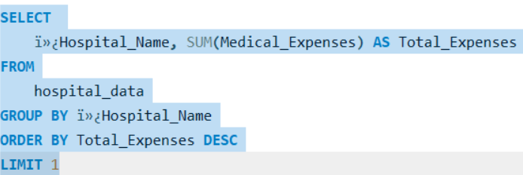

dentify the hospital that recorded the highest medical expenses.

Slide 7
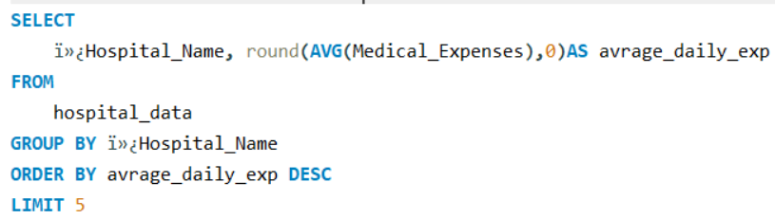
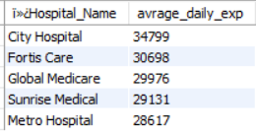
Calculate the average medical expenses per day for each hospital.

Slide 8
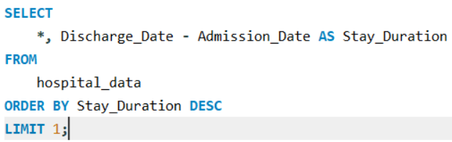
Find the patient with the longest stay by calculating the difference between Discharge Date and Admission Date.

Slide 9
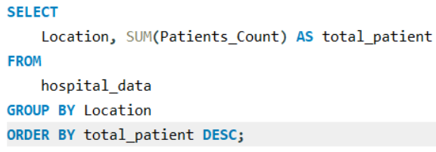
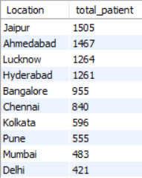
Count the total number of patients treated in each city.

Slide 10
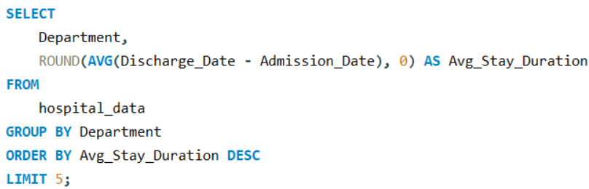
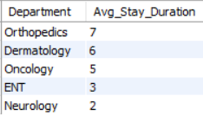
Calculate the average number of days patients spend in each department.

Slide 11
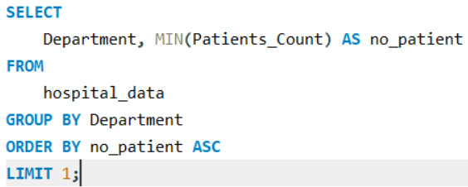

Find the department with the least number of patients.

Slide 12
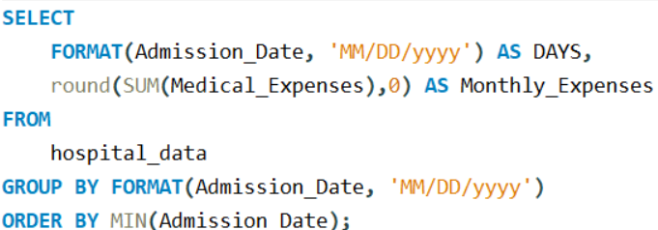
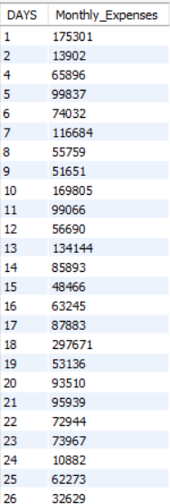
Group the data by month and calculate the total medical expenses for each month.
Note : - Summary URL
https://docs.google.com/document/d/120NY1OQGyogkDLZ0LmZwAN3mr3Qe0sWyN2AViWPpUD8/edit?usp=sharing

